Slide 1
Unit Testing with JUnit

Slide 2

Bugs and testing
software reliability: Probability that a software system will not cause failure under specified conditions.
  Measured by uptime, MTTF (mean time till failure), crash data.
Bugs are inevitable in any complex software system.
  Industry estimates: 10-50 bugs per 1000 lines of code.
  A bug can be visible or can hide in your code until much later.
testing: A systematic attempt to reveal errors.
  Failed test: an error was demonstrated.
  Passed test: no error was found (for this particular situation).

Slide 3
Difficulties of testing
Perception by some developers and managers:
  Testing is seen as a novice's job.
  Assigned to the least experienced team members.
  Done as an afterthought (if at all).
    "My code is good; it won't have bugs. I don't need to test it."
    "I'll just find the bugs by running the client program."
Limitations of what testing can show you:
  It is impossible to completely test a system.
  Testing does not always directly reveal the actual bugs in the code.
  Testing does not prove the absence of errors in software.

Slide 4

Unit testing
unit testing: Looking for errors in a subsystem in isolation.
  Generally a "subsystem" means a particular class or object.
  The Java library JUnit helps us to easily perform unit testing.
The basic idea:
  For a given class Foo, create another class FooTest to test it, containing various "test case" methods to run.
  Each method looks for particular results and passes / fails.
JUnit provides "assert" commands to help us write tests.
  The idea: Put assertion calls in your test methods to check things you expect to be true. If they aren't, the test will fail.

Slide 5
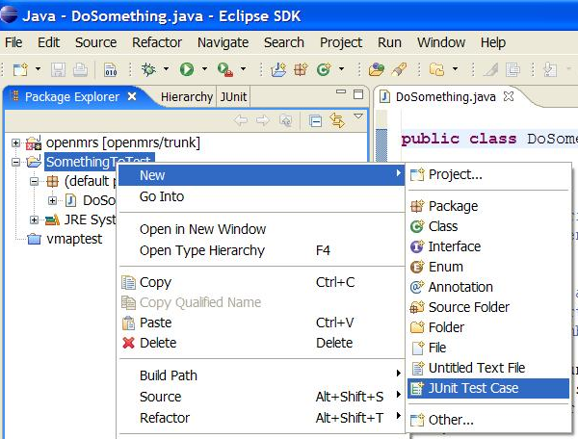
JUnit and Eclipse
To add JUnit to an Eclipse project, click:
  Project → Properties → Build Path → Libraries →
  Add Library... → JUnit → JUnit 5 → Finish
To create a test case:
  right-click a file and
  choose New → Test Case
  or click File → New →
  JUnit Test Case
  Eclipse can create stubs
  of method tests for you.

Slide 6
A JUnit test class
  import org.junit.*;
  import static org.junit.Assert.*;
  public class name {
  ...
  @Test
  public void name() { // a test case method
  ...
  }
  }
  A method with @Test is flagged as a JUnit test case.
    All @Test methods run when JUnit runs your test class.

Slide 7
JUnit assertion methods
Each method can also be passed a string to display if it fails:
  e.g. assertEquals("message", expected, actual)
  Why is there no pass method?
assertTrue(test) | fails if the boolean test is false
assertFalse(test) | fails if the boolean test is true
assertEquals(expected, actual) | fails if the values are not equal
assertSame(expected, actual) | fails if the values are not the same (by ==)
assertNotSame(expected, actual) | fails if the values are the same (by ==)
assertNull(value) | fails if the given value is not null
assertNotNull(value) | fails if the given value is null
fail() | causes current test to immediately fail

Slide 8
ArrayIntList JUnit test
  import org.junit.*;
  import static org.junit.Assert.*;
  public class TestArrayIntList {
  @Test
  public void testAddGet1() {
  ArrayIntList list = new ArrayIntList();
  list.add(42);
  list.add(-3);
  list.add(15);
  assertEquals(42, list.get(0));
  assertEquals(-3, list.get(1));
  assertEquals(15, list.get(2));
  }
  @Test
  public void testIsEmpty() {
  ArrayIntList list = new ArrayIntList();
  assertTrue(list.isEmpty());
  list.add(123);
  assertFalse(list.isEmpty());
  list.remove(0);
  assertTrue(list.isEmpty());
  }
  ...

Slide 9
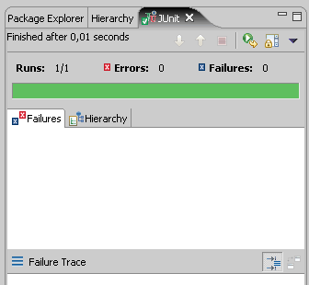
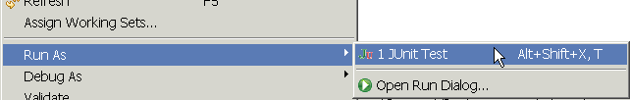
Running a test
Right click it in the Eclipse Package Explorer at left; choose:
  Run As → JUnit Test
The JUnit bar will show green if all tests pass, red if any fail.
The Failure Trace shows which tests
failed, if any, and why.

Slide 10
JUnit exercise
Given a Date class with the following methods:
  public Date(int year, int month, int day)
  public Date() // today
  public int getDay(), getMonth(), getYear()
  public void addDays(int days) // advances by days
  public int daysInMonth()
  public String dayOfWeek() // e.g. "Sunday"
  public boolean equals(Object o)
  public boolean isLeapYear()
  public void nextDay() // advances by 1 day
  public String toString()
Come up with unit tests to check the following:
  That no Date object can ever get into an invalid state.
  That the addDays method works properly.
    It should be efficient enough to add 1,000,000 days in a call.
Notes:
a good equals method has some initial checks like checking for null, checking whether this == that, check instanceof, etc... then it calls compareTo

Slide 11
What's wrong with this?
public class DateTest {
@Test
public void test1() {
Date d = new Date(2050, 2, 15);
d.addDays(4);
assertEquals(d.getYear(), 2050);
assertEquals(d.getMonth(), 2);
assertEquals(d.getDay(), 19);
}
@Test
public void test2() {
Date d = new Date(2050, 2, 15);
d.addDays(14);
assertEquals(d.getYear(), 2050);
assertEquals(d.getMonth(), 3);
assertEquals(d.getDay(), 1);
}
}

Slide 12
Well-structured assertions
public class DateTest {
@Test
public void test1() {
Date d = new Date(2050, 2, 15);
d.addDays(4);
assertEquals(2050, d.getYear()); // expected
assertEquals(2, d.getMonth()); // value should
assertEquals(19, d.getDay()); // be at LEFT
}
@Test
public void test2() {
Date d = new Date(2050, 2, 15);
d.addDays(14);
assertEquals("year after +14 days", 2050, d.getYear());
assertEquals("month after +14 days", 3, d.getMonth());
assertEquals("day after +14 days", 1, d.getDay());
} // test cases should usually have messages explaining
} // what is being checked, for better failure output

Slide 13
Expected answer objects
public class DateTest {
@Test
public void test1() {
Date d = new Date(2050, 2, 15);
d.addDays(4);
Date expected = new Date(2050, 2, 19);
assertEquals(expected, d); // use an expected answer
} // object to minimize tests
// (Date must have toString
@Test // and equals methods)
public void test2() {
Date d = new Date(2050, 2, 15);
d.addDays(14);
Date expected = new Date(2050, 3, 1);
assertEquals("date after +14 days", expected, d);
}
}

Slide 14
Naming test cases
public class DateTest {
@Test
public void test_addDays_withinSameMonth_1() {
Date actual = new Date(2050, 2, 15);
actual.addDays(4);
Date expected = new Date(2050, 2, 19);
assertEquals("date after +4 days", expected, actual);
}
// give test case methods really long descriptive names
@Test
public void test_addDays_wrapToNextMonth_2() {
Date actual = new Date(2050, 2, 15);
actual.addDays(14);
Date expected = new Date(2050, 3, 1);
assertEquals("date after +14 days", expected, actual);
}
// give descriptive names to expected/actual values
}

Slide 15
What's wrong with this?
public class DateTest {
@Test
public void test_addDays_addJustOneDay_1() {
Date actual = new Date(2050, 2, 15);
actual.addDays(1);
Date expected = new Date(2050, 2, 16);
assertEquals(
"should have gotten " + expected + "\n" +
" but instead got " + actual\n",
expected, actual);
}
...
}

Slide 16
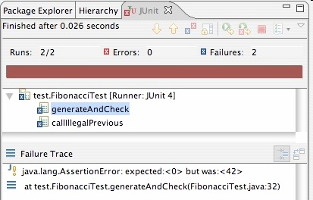
Good assertion messages
public class DateTest {
@Test
public void test_addDays_addJustOneDay_1() {
Date actual = new Date(2050, 2, 15);
actual.addDays(1);
Date expected = new Date(2050, 2, 16);
assertEquals("adding one day to 2050/2/15",
expected, actual);
}
...
}
// JUnit will already show
// the expected and actual
// values in its output;
//
// don't need to repeat them
// in the assertion message

Slide 17
Tests with a timeout
  @Test(timeout = 5000)
  public void name() { ... }
  The above method will be considered a failure if it doesn't finish running within 5000 ms
  private static final int TIMEOUT = 2000;
  ...
  @Test(timeout = TIMEOUT)
  public void name() { ... }
  Times out / fails after 2000 ms

Slide 18
Pervasive timeouts
public class DateTest {
@Test(timeout = DEFAULT_TIMEOUT)
public void test_addDays_withinSameMonth_1() {
Date d = new Date(2050, 2, 15);
d.addDays(4);
Date expected = new Date(2050, 2, 19);
assertEquals("date after +4 days", expected, d);
}
@Test(timeout = DEFAULT_TIMEOUT)
public void test_addDays_wrapToNextMonth_2() {
Date d = new Date(2050, 2, 15);
d.addDays(14);
Date expected = new Date(2050, 3, 1);
assertEquals("date after +14 days", expected, d);
}
// almost every test should have a timeout so it can't
// lead to an infinite loop; good to set a default, too
private static final int DEFAULT_TIMEOUT = 2000;
}

Slide 19
Testing for exceptions
  @Test(expected = ExceptionType.class)
  public void name() {
  ...
  }
  Will pass if it does throw the given exception.
    If the exception is not thrown, the test fails.
    Use this to test for expected errors.
  @Test(expected = ArrayIndexOutOfBoundsException.class)
  public void testBadIndex() {
  ArrayIntList list = new ArrayIntList();
  list.get(4); // should fail
  }

Slide 20
Setup and teardown
  @Before
  public void name() { ... }
  @After
  public void name() { ... }
  methods to run before/after each test case method is called
  @BeforeClass
  public static void name() { ... }
  @AfterClass
  public static void name() { ... }
  methods to run once before/after the entire test class runs

Slide 21
Tips for testing
You cannot test every possible input, parameter value, etc.
  So you must think of a limited set of tests likely to expose bugs.
Think about boundary cases
  positive; zero; negative numbers
  right at the edge of an array or collection's size
Think about empty cases and error cases
  0, -1, null; an empty list or array
test behavior in combination
  maybe add usually works, but fails after you call remove
  make multiple calls; maybe size fails the second time only

Slide 22
What's wrong with this?
public class DateTest {
// test every day of the year
@Test(timeout = 10000)
public void tortureTest() {
Date date = new Date(2050, 1, 1);
int month = 1;
int day = 1;
for (int i = 1; i < 365; i++) {
date.addDays(1);
if (day < DAYS_PER_MONTH[month]) {day++;}
else {month++; day=1;}
assertEquals(new Date(2050, month, day), date);
}
}
private static final int[] DAYS_PER_MONTH = {
0, 31, 28, 31, 30, 31, 30, 31, 31, 30, 31, 30, 31
}; // Jan Feb Mar Apr May Jun Jul Aug Sep Oct Nov Dec
}

Slide 23
Trustworthy tests
Test one thing at a time per test method.
  10 small tests are much better than 1 test 10x as large.
Each test method should have few (likely 1) assert statements.
  If you assert many things, the first that fails stops the test.
  You won't know whether a later assertion would have failed.
Tests should avoid logic.
  minimize if/else, loops, switch, etc.
  avoid try/catch
    If it's supposed to throw, use expected= ... if not, let JUnit catch it.
Torture tests are okay, but only in addition to simple tests.

Slide 24
Squashing redundancy
public class DateTest {
@Test(timeout = DEFAULT_TIMEOUT)
public void addDays_withinSameMonth_1() {
addHelper(2050, 2, 15, +4, 2050, 2, 19);
}
@Test(timeout = DEFAULT_TIMEOUT)
public void addDays_wrapToNextMonth_2() {
addHelper(2050, 2, 15, +14, 2050, 3, 1);
}
// use lots of helpers to make actual tests extremely short
private void addHelper(int y1, int m1, int d1, int add,
int y2, int m2, int d2) {
Date act = new Date(y, m, d);
actual.addDays(add);
Date exp = new Date(y2, m2, d2);
assertEquals("after +" + add + " days", exp, act);
}
// can also use "parameterized tests" in some frameworks
...

Slide 25
Flexible helpers
public class DateTest {
@Test(timeout = DEFAULT_TIMEOUT)
public void addDays_multipleCalls_wrapToNextMonth2x() {
Date d = addHelper(2050, 2, 15, +14, 2050, 3, 1);
addhelper(d, +32, 2050, 4, 2);
addhelper(d, +98, 2050, 7, 9);
}
// Helpers can box you in; hard to test many calls/combine.
// Create variations that allow better flexibility
private Date addHelper(int y1, int m1, int d1, int add,
int y2, int m2, int d2) {
Date date = new Date(y, m, d);
addHelper(date, add, y2, m2, d2);
return d;
}
private void addHelper(Date date, int add,
int y2, int m2, int d2) {
date.addDays(add);
Date expect = new Date(y2, m2, d2);
assertEquals("date after +" + add + " days", expect, d);
}
...

Slide 26
Regression testing
regression: When a feature that used to work, no longer works.
  Likely to happen when code changes and grows over time.
  A new feature/fix can cause a new bug or reintroduce an old bug.
regression testing: Re-executing prior unit tests after a change.
  Often done by scripts during automated testing.
  Used to ensure that old fixed bugs are still fixed.
  Gives your app a minimum level of working functionality.
Many products have a set of mandatory check-in tests that must pass before code can be added to a source code repository.

Slide 27
Test-driven development
Unit tests can be written after, during, or even before coding.
  test-driven development: Write tests, then write code to pass them.
Imagine that we'd like to add a method subtractWeeks to our Date class, that shifts this Date backward in time by the given number of weeks.
Write code to test this method before it has been written.
  Then once we do implement the method, we'll know if it works.

Slide 28
Tests and data structures
Need to pass lots of arrays? Use array literals
  public void exampleMethod(int[] values) { ... }
  ...
  exampleMethod(new int[] {1, 2, 3, 4});
  exampleMethod(new int[] {5, 6, 7});
Need a quick ArrayList? Try Arrays.asList
  List<Integer> list = Arrays.asList(7, 4, -2, 3, 9, 18);
Need a quick set, queue, etc.? Many collections can take a list
  Set<Integer> list = new HashSet<Integer>(
  Arrays.asList(7, 4, -2, 9));

Slide 29
What's wrong with this?
public class DateTest {
// shared Date object to test with (saves memory!!1)
private static Date DATE;
@Test(timeout = DEFAULT_TIMEOUT)
public void addDays_sameMonth() {
DATE = new Date(2050, 2, 15); // first test;
addhelper(DATE, +4, 2050, 2, 19); // DATE = 2/15 here
}
@Test(timeout = DEFAULT_TIMEOUT)
public void addDays_nextMonthWrap() { // second test;
addhelper(DATE, +10, 2050, 3, 1); // DATE = 2/19 here
}
@Test(timeout = DEFAULT_TIMEOUT)
public void addDays_multipleCalls() { // third test;
addDays_sameMonth(); // go back to 2/19;
addhelper(DATE, +1, 2050, 2, 20); // test two calls
addhelper(DATE, +1, 2050, 2, 21);
}
...
}

Slide 30

Test case "smells"
Tests should be self-contained
and not care about each other.
"Smells" (bad things to avoid) in tests:
  Constrained test order : Test A must run before Test B.
  (usually a misguided attempt to test order/flow)
  Tests call each other : Test A calls Test B's method
  (calling a shared helper is OK, though)
  Mutable shared state : Tests A/B both use a shared object.
  (If A breaks it, what happens to B?)

Slide 31
Test suites
test suite: One class that runs many JUnit tests.
  An easy way to run all of your app's tests at once.
  import org.junit.runner.*;
  import org.junit.runners.*;
  @RunWith(Suite.class)
  @Suite.SuiteClasses({
  TestCaseName.class,
  TestCaseName.class,
  ...
  TestCaseName.class,
  })
  public class name {}

Slide 32
Test suite example
  import org.junit.runner.*;
  import org.junit.runners.*;
  @RunWith(Suite.class)
  @Suite.SuiteClasses({
  WeekdayTest.class,
  TimeTest.class,
  CourseTest.class,
  ScheduleTest.class,
  CourseComparatorsTest.class
  })
  public class HW2Tests {}

Slide 33
JUnit summary
Tests need failure atomicity (ability to know exactly what failed).
  Each test should have a clear, long, descriptive name.
  Assertions should always have clear messages to know what failed.
  Write many small tests, not one big test.
    Each test should have roughly just 1 assertion at its end.
Always use a timeout parameter to every test.
Test for expected errors / exceptions.
Choose a descriptive assert method, not always assertTrue.
Choose representative test cases from equivalent input classes.
Avoid complex logic in test methods if possible.
Use helpers, @Before to reduce redundancy between tests.

